Slide 1



PARENTING & DOMESTIC ABUSE GROUPS
WHAT GROUP IS BEST FOR ME?
Ask yourself:
Are you struggling to understand your child’s behaviour?
Do you need support in how to manage your children's emotions?
Is your relationship with your child becoming a battle?
Parenting Programmes
  The Solihull Approach
  Triple P 0-12
  Teen Triple P
  Triple P Transitions
  Triple P Stepping Stones
Domestic Abuse
  Freedom
THE SOLIHULL PROGRAMME COULD BE FOR YOU, IT IS FOR PARENTS & CARERS WITH CHILDREN 0-11 YEARS WHO WANT TO KNOW MORE ABOUT SENSITIVE AND EFFECTIVE PARENTING
The Solihull Approach 10 week course aims to:-
Promote understanding of children’s behaviour
Tune into children
Explore feelings & emotions
Give you as parents/carers a strategy for repair when things go wrong
Develop a framework for thinking about parent/child relationships, which can be developed into a lifelong skill
Promote reflective, sensitive and effective parenting

Slide 2


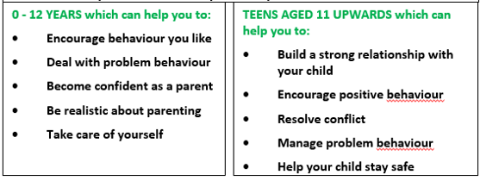
Is this you?
You’re divorced or separated. Your child is caught in the middle. You may have problems with your extended family, your new partner or your ex.
Holidays and birthdays cause arguments. You may be concerned about your finances, and you’re worried about the impact this is all having on your child’s behaviour and emotions. If this sounds familiar, Family Transitions Triple P can help.
What Is Family Transitions Triple P?
Family Transitions is a group parenting programme for divorced or separated parents. It gives you new ways to help protect your child – and yourself – from the fallout from a family split.
What happens at Family Transitions?
At Family Transitions sessions, you meet other parents going through many of the problems that come with divorce or separation. You will get new ideas, techniques and strategies to help you through the day-to-day dramas and ongoing trauma of your situation. These ideas can help you cope with stress, anger and change, resolve conflict, and communicate better with your ex.
Throughout the sessions, you’ll also watch the Family Transitions DVD, which shows how other parents have used the ideas to help their families. And you’ll also receive the Family Transitions Workbook to support you as you put your new ideas into practice.
IS THIS YOUR FAMILY?
Your child constantly misbehaves
Other families don’t seem to have it as tough as you
Your family life is full of anger and tears
There’s probably a lot of shouting
From breakfast to bedtime, it’s a battle
IF THIS SOUNDS LIKE YOUR FAMILY, TRIPLE P IS A POSITIVE PARENTING PROGRAMME OVER A PERIOD OF 8 WEEKS FOR PARENTS & CARERS OF CHILDREN FOR ALL AGE GROUPS
TRIPLE P STEPPING STONES GROUP FOR PARENTS/CARERS WHOSE CHILDREN HAVE ADDITIONAL NEEDS
This group is for six weeks, learning new skills, followed by three individual telephone consultations to help parents refine problem solving skills, helping prevent the development of problem behaviour.

Slide 3
How do I join a parenting group
Please email CFSS@nctrust.co.uk
Let us know:-
What group you would like to join from the timetable below
Parent email address
Your phone number
How long does it take?
There are five weekly sessions of two hours each. After the five sessions,
you are welcome to join other parenting groups offered by Children and Family Support Services.
Does my ex-partner need to attend with me?
No. Family Transitions is not a mediation programme so you should attend
on your own or, if you want support, with your new partner. If your ex-partner wants to do Family Transitions, you should attend separate groups.

Slide 4

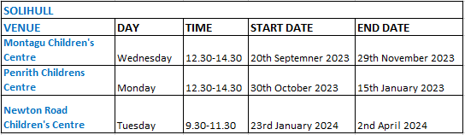
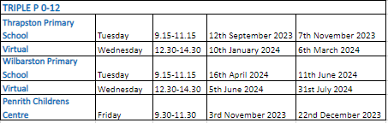
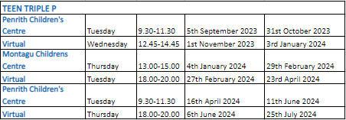
Strengthening Families North Course Timetable
Freedom Programme
What is Freedom Programme?
Freedom Programme is a domestic violence programme which is primarily designed for women as victims of domestic violence
The Programme also describes in detail how children are affected by being exposed to this kind of abuse, and most importantly how their lives are improved when the abuse is removed.
Please contact the following Family Hubs for further details:-
Kingsthorpe Children’s Centre
St David’s Road
Kingsthorpe
NN2 6NS
Tel 01604 791537
Email: cfss@nctrust.co.uk
Penrith Family Hub
Penrith Drive
Wellingborough
NN8 3XL
Tel 01604 361373
Email: cfss@nctrust.co.uk

Slide 5
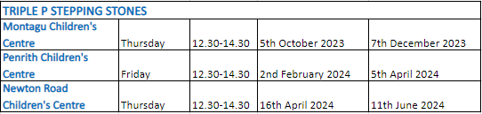
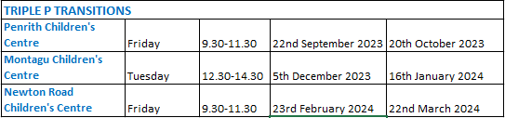
Strengthening Families North Course Timetable
All Parenting Programme Referrals to be sent to CFSS@NCTrust.co.uk

