Slide 1
Appendix 1. Questions in order of agreement from parent responses
(1 Strongly Agree, 2 Agree, 3 Neither agree/disagree, 4 Disagree, 5 Strongly Disagree)
Question (n = number of responses) | Average
The school keeps my child safe (n = 87) | 1.71
My child enjoys being at school most days (n = 87) | 1.94
The school instils morals and positive attitudes in my child (n = 85) | 1.96
This is a good school and I am proud my child attends it (n = 85) | 2.08
My child is making good progress (n = 85) | 2.13
Staff treat my child fairly and with respect (n = 85) | 2.13
The school teaches diverse and tolerant attitudes (n = 85) | 2.14
Pupils at the school behave well (n = 85) | 2.15
Staff are aspirational for my child (n = 85) | 2.18
My child finds the staff approachable (n = 85) | 2.24
I am happy with the provision of school trips and enrichment activities (n = 85) | 2.32
I would recommend this school to others (n = 84) | 2.32
The school has a good reputation in the local community (n = 85) | 2.34
The school is welcoming and friendly (n = 86) | 2.35
My child receives age appropriate homework (n = 85) | 2.39
The school encourages my child to exercise and participate in sports (n = 85) | 2.45
The school has an effective governing body (n = 84) | 2.55
The school has strong leadership and is well managed (n = 84) | 2.62
I am kept well informed about how my child is progressing (n = 85) | 2.65
I am happy with the overall communications from school to home (n = 85) | 2.66
Any bullying issues are dealt with appropriately (n = 85) | 2.76
The school is good at seeking the views of parents (n = 84) | 2.88

Slide 2
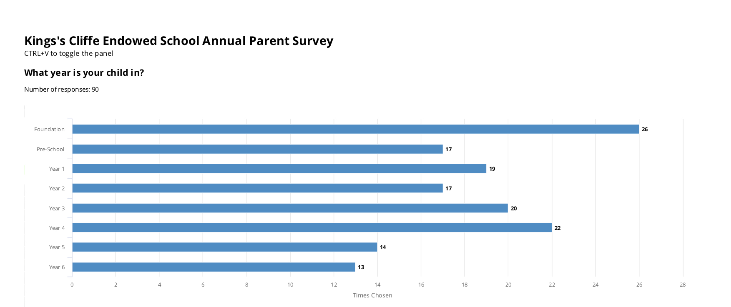
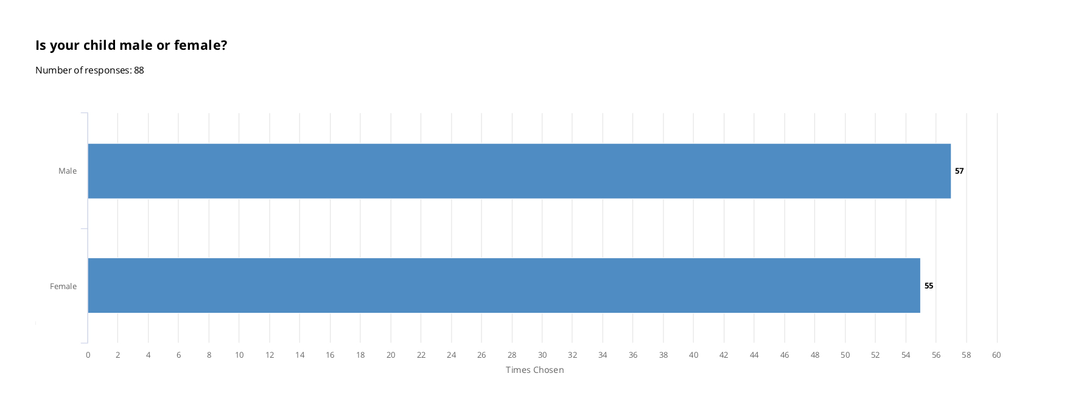
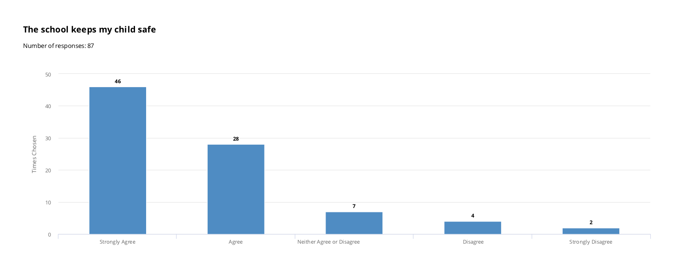
Appendix 2. Graphs showing responses for each question

Slide 3
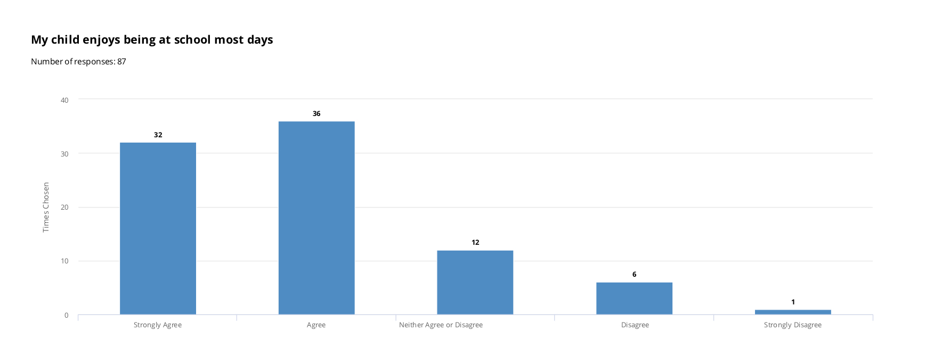
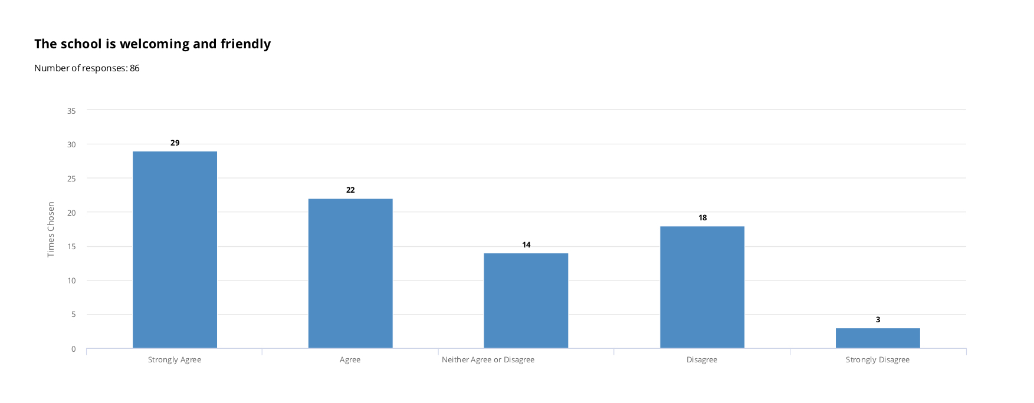
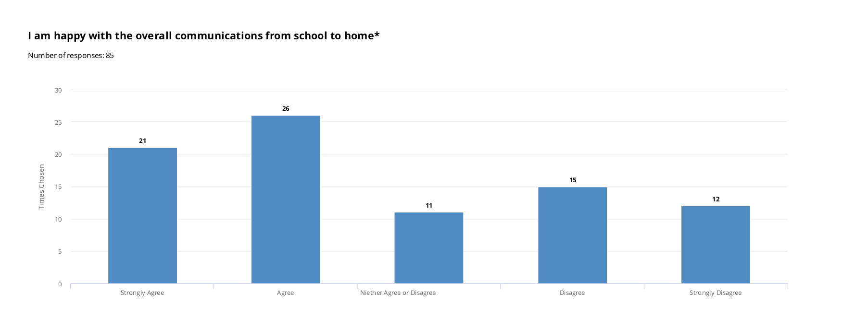

Slide 4
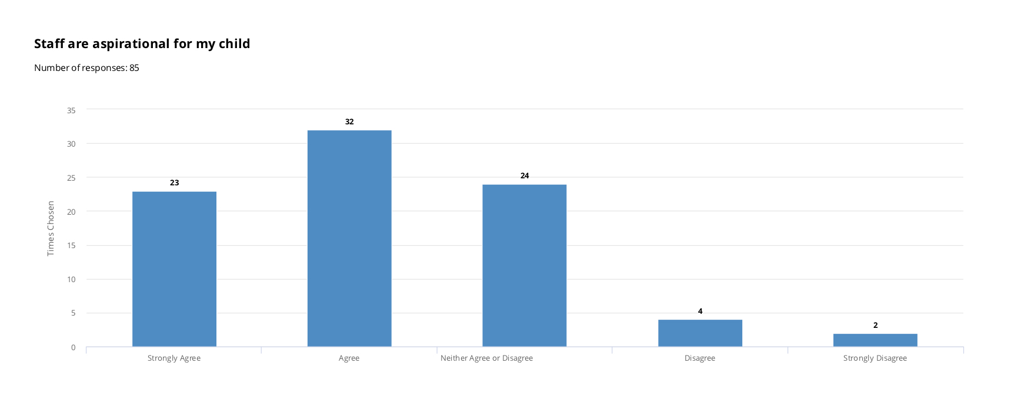
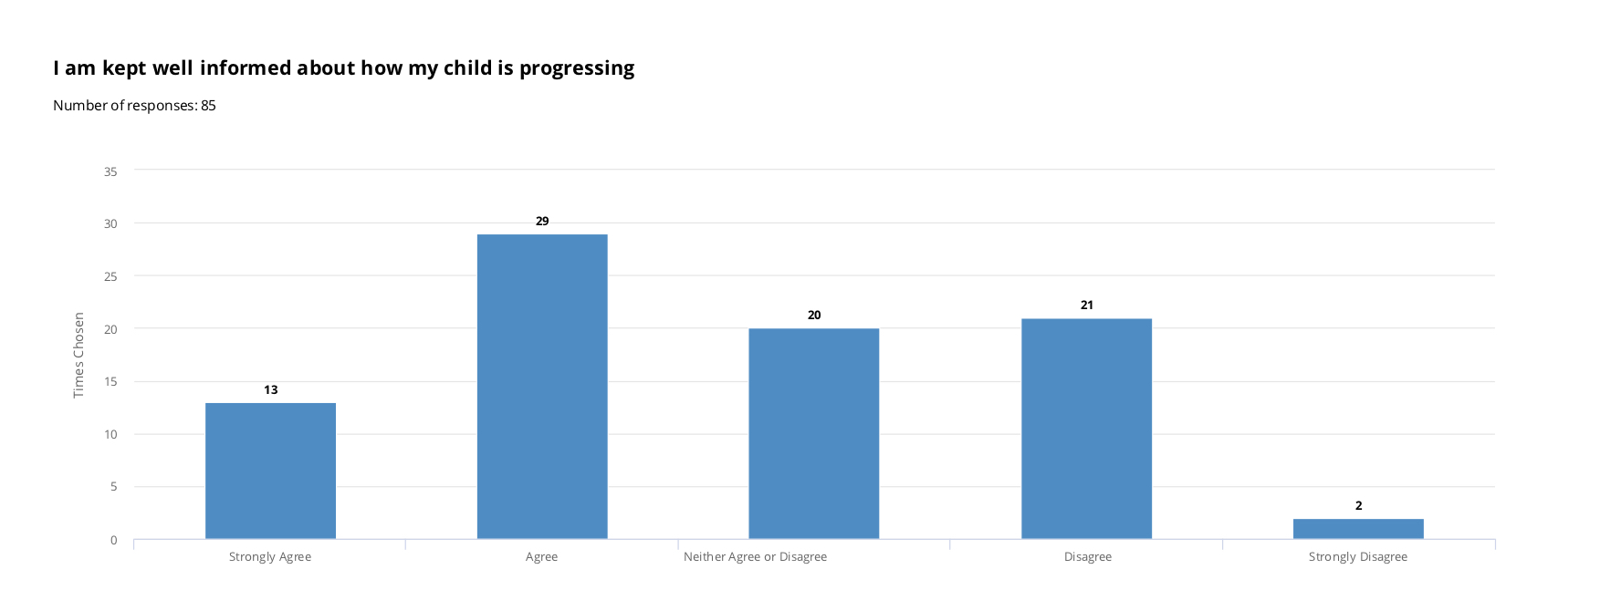
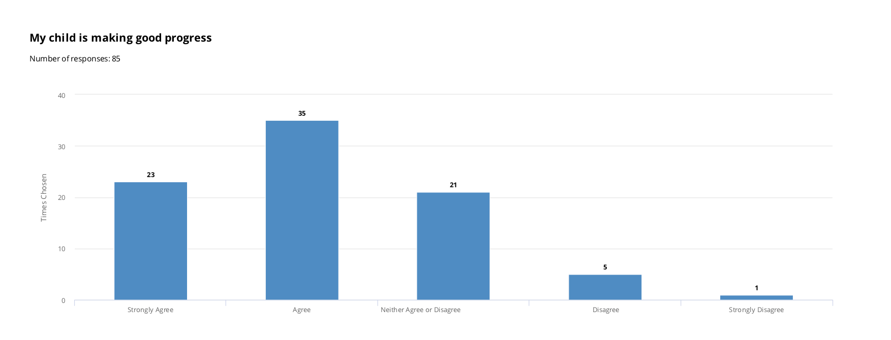

Slide 5
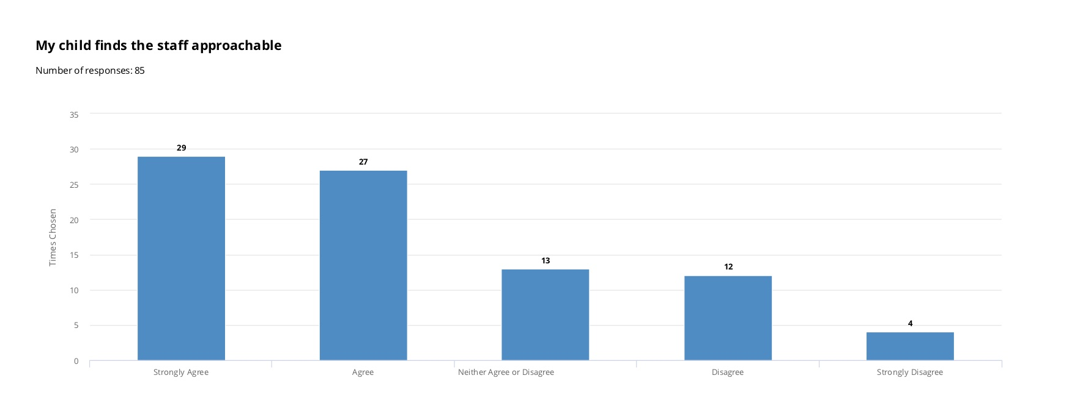
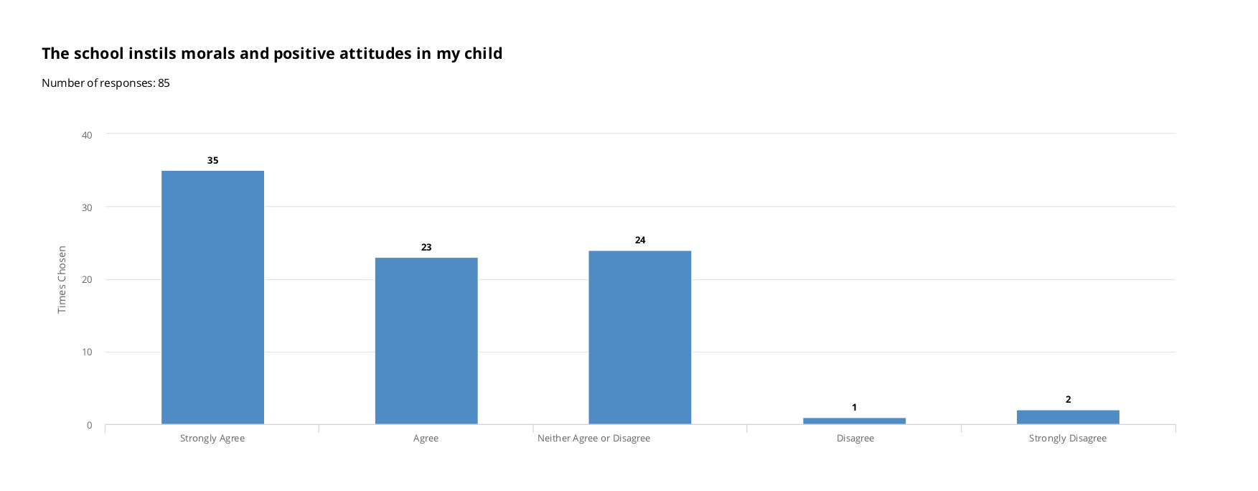
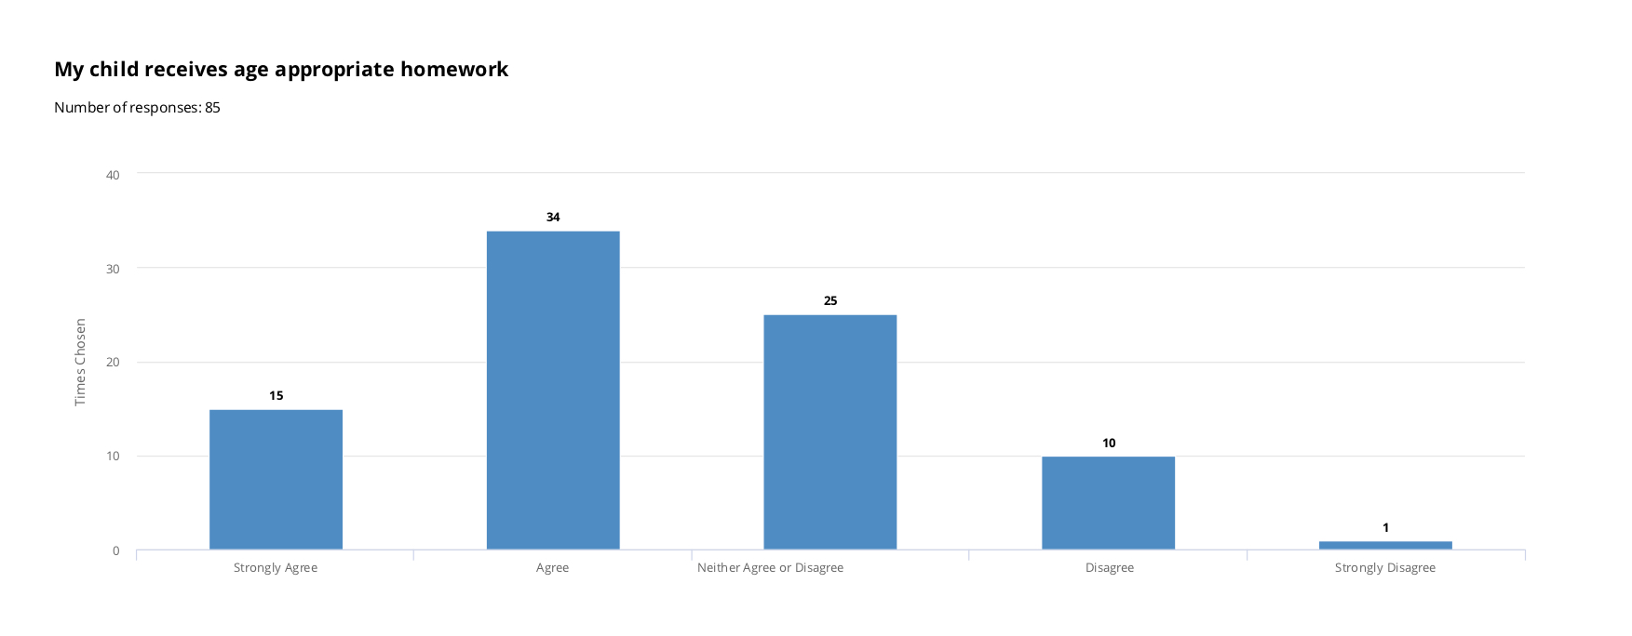

Slide 6
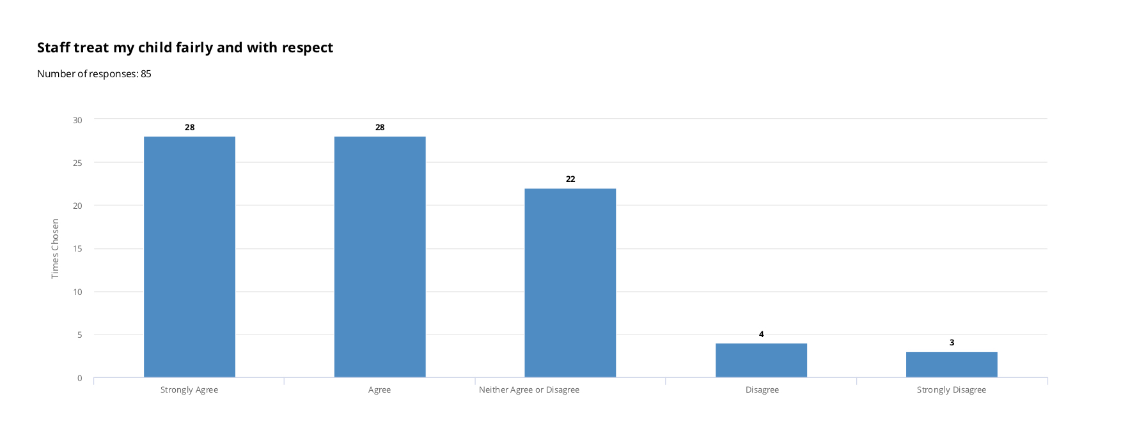
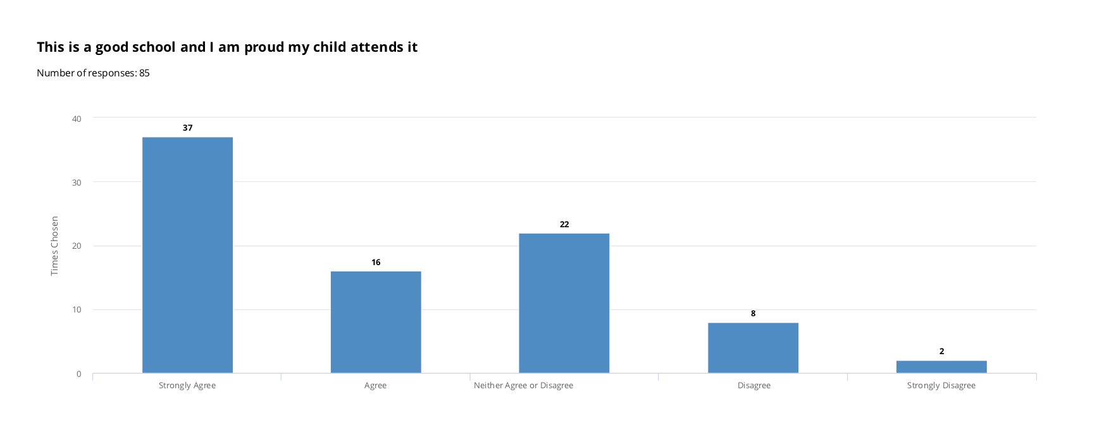
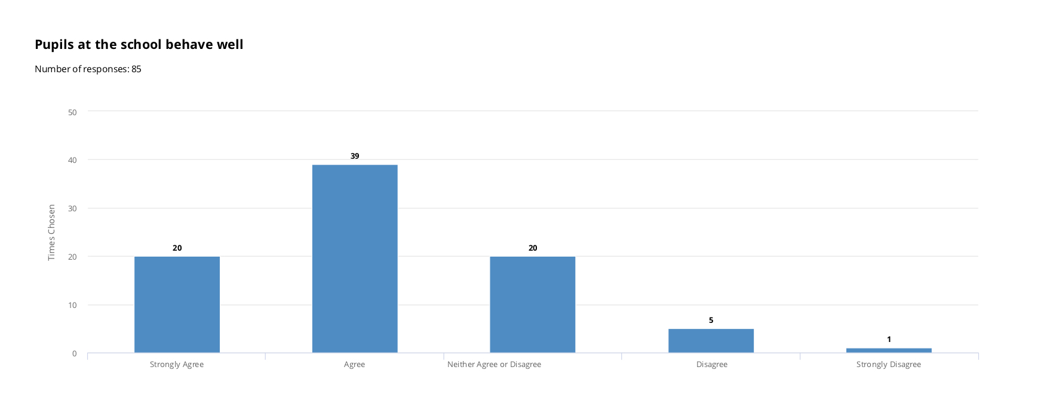

Slide 7
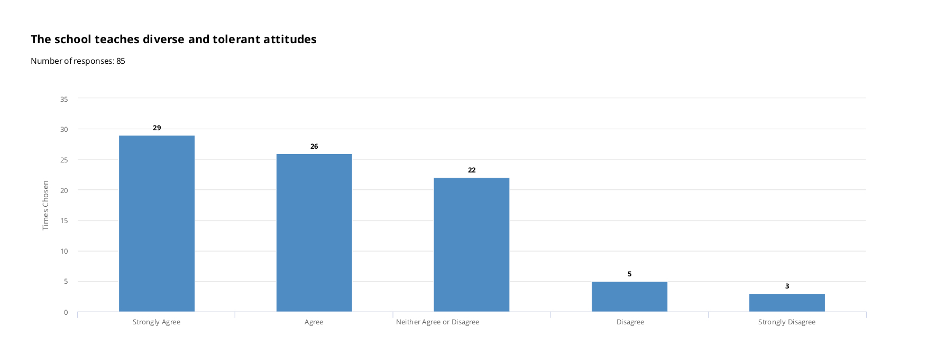
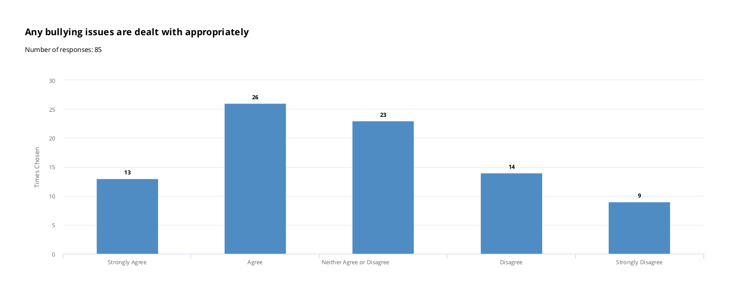
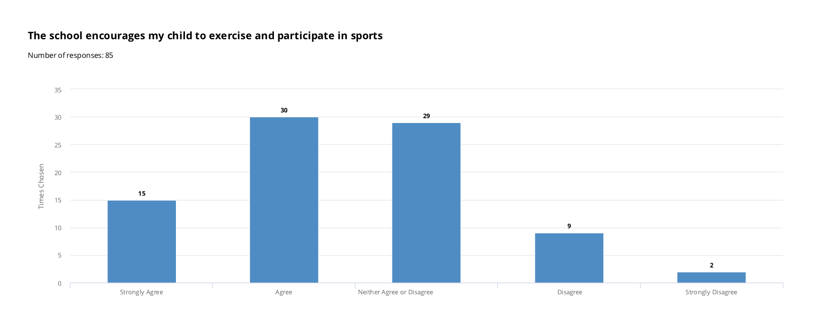

Slide 8
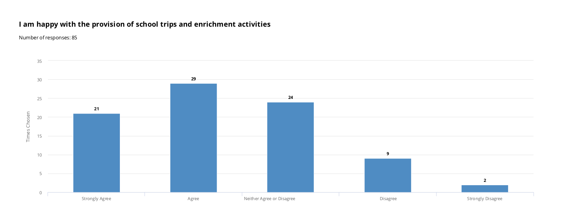
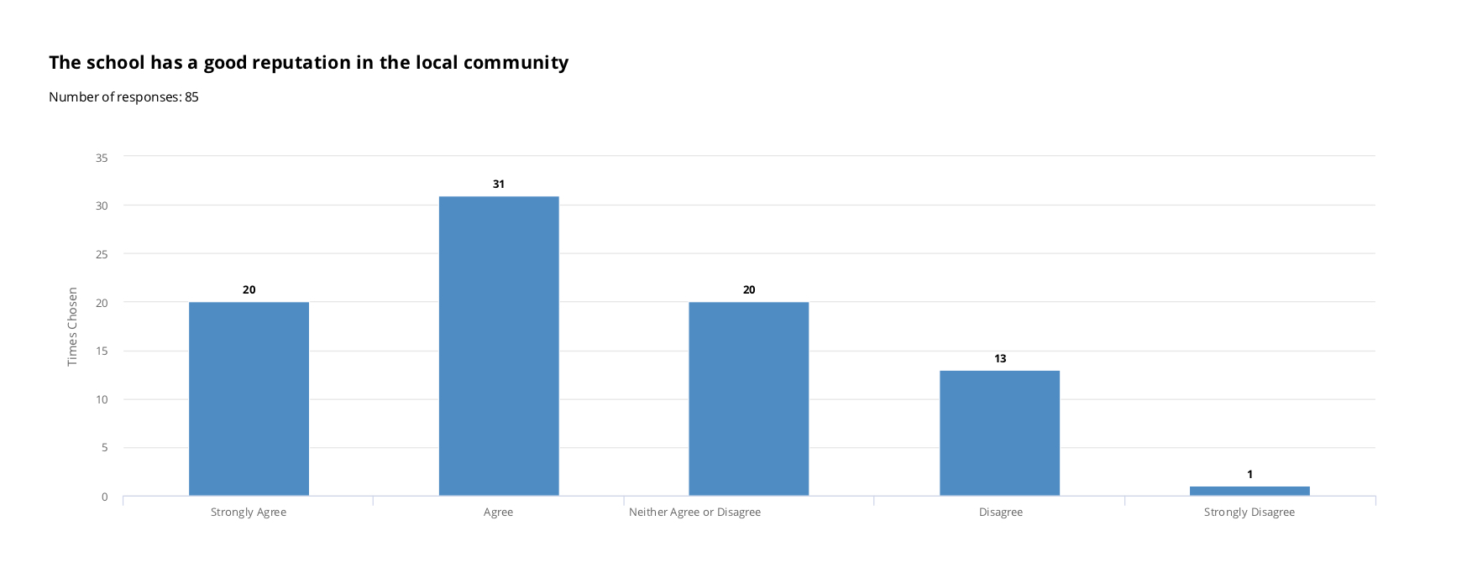
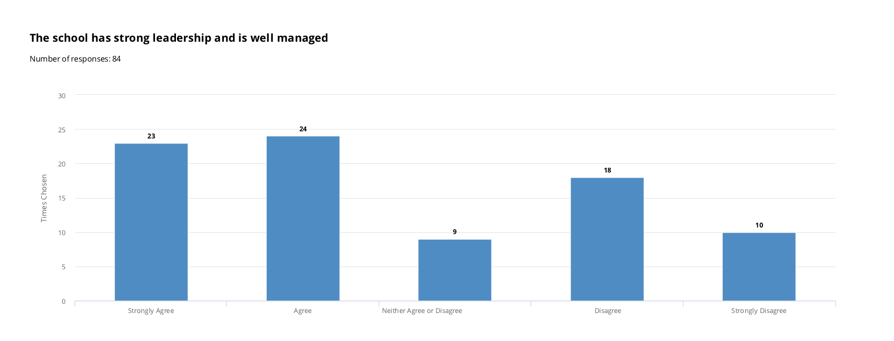

Slide 9


